Slide 1
Data Processing System
9/4/2020 Update

Slide 2
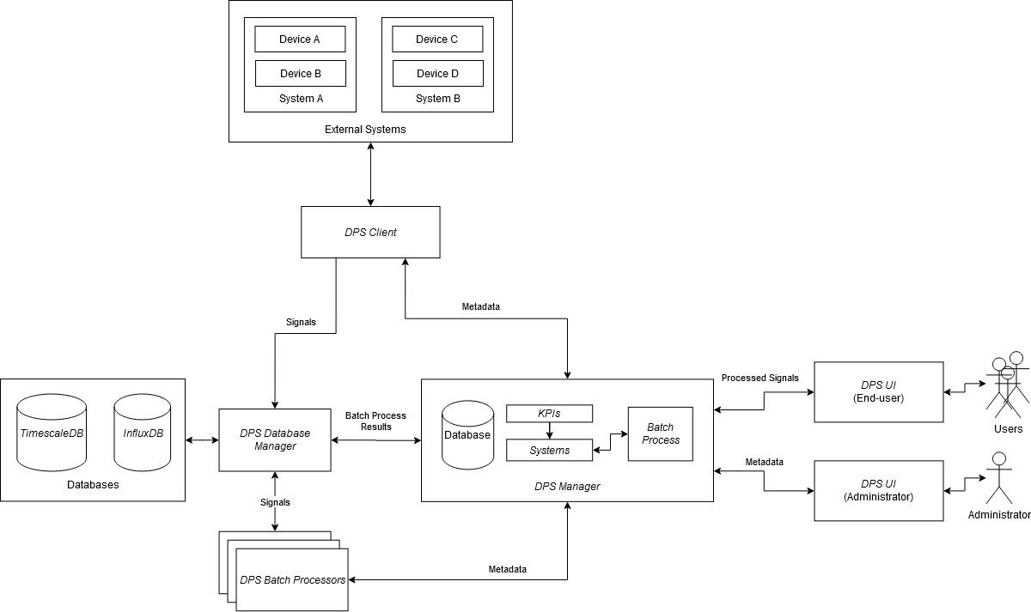
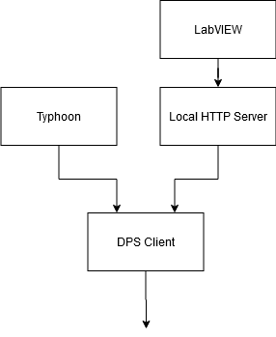
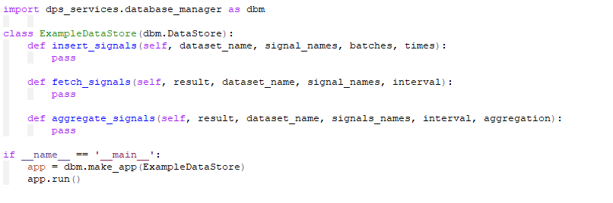
Overview
Architecture Update
Database Manager
LabVIEW Integration

Slide 3
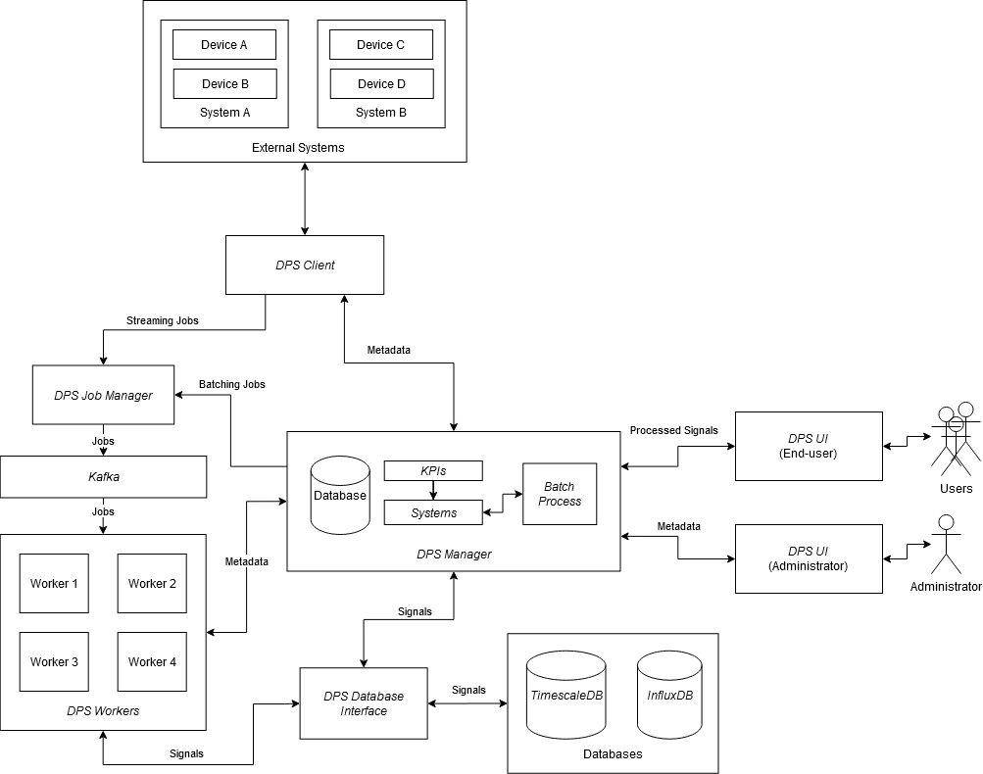
Architecture Update
No requirement for streaming KPIs
Leads to a simplified design

Slide 4
Previous Architecture

Slide 5
Updated Architecture

Slide 6
Differences
No Streaming capabilities
Simple design
No dependency on Kafka
Less components
Easier deployment
Faster development

Slide 7
Database Manager
UWM and Eaton implement their own instances of Database Manager
Python package dps_services
Decouples database interface code with API
Object-oriented design

Slide 8
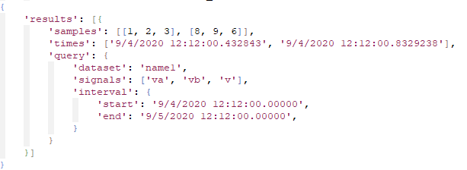
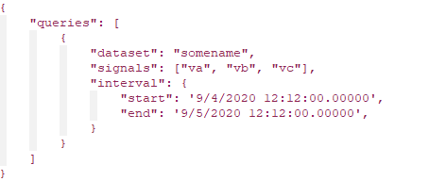
Database Manager – Query API
Request
Response

Slide 9
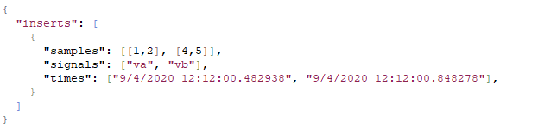
Database Manager – Insert API
Request

Slide 10
Database Manager – An Implementation

Slide 11
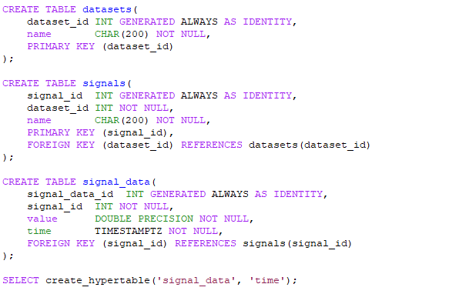
Database Manager – UWM Schema

Slide 12
LabVIEW Integration
Local web-server to buffer requests
Uses DPS Client

Slide 13
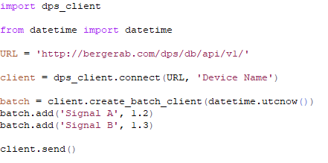
LabVIEW Integration – DPS Client

Slide 14
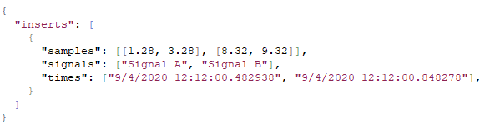
LabVIEW Integration – Local Web Server
HTTP POST to localhost
HTTP POST to Database Manager
(after buffering)

Slide 15
Questions

